Slide 1

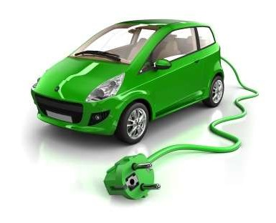
Hybrid Electric Vehicles: EE 6435 D
Module 2
Presented by
Dr. V. Karthikeyan
Assistant Professor
Department of Electrical Engineering
National Institute of Technology Calicut
Notes:
‹#›

Slide 2
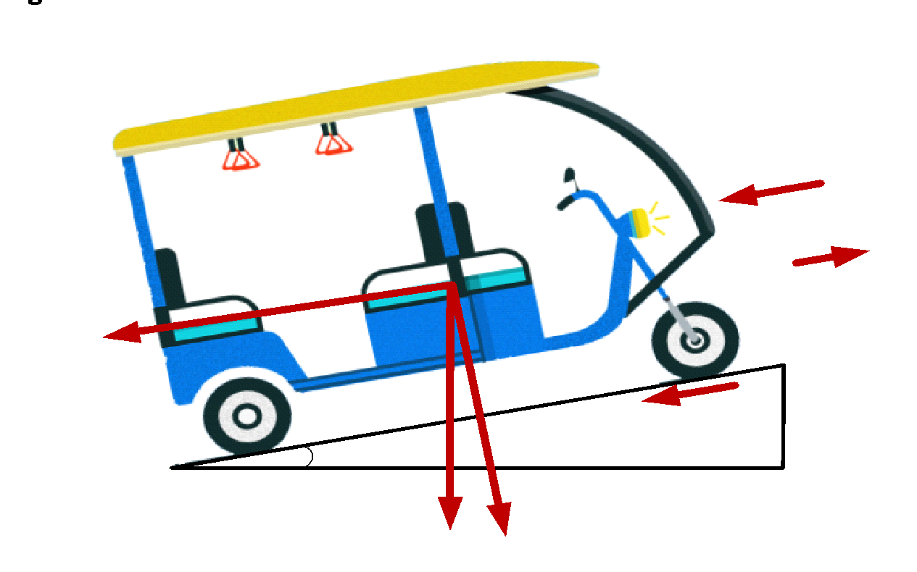
Design of Electric Vehicle
1. Aerodynamic Drag
Aerodynamic drag is the resistance of air to the movement of the vehicle. The aerodynamic drag force FD and power PD acting on the vehicle are defined as
F_{D}= 0.5*ρ*C_{D}*A*(V+V_{air})²
ρ = Air density @ 27˚C = 1.2 kg/m3
CD = Drag coefficient (Standard value: 0.44)
^{V = Vehicle speed (m/s)}
V_{air}^{= Wind Velocity (m/s)}
A = Vehicle frontal area (sq. m) (Standard value:1.2 to 2)
The drag force increases with the cross-sectional area of the vehicle and also increases or decreases depending on whether the vehicle is experiencing a headwind or a tailwind.
A tailwind results in a negative speed and reduced drag, and the net air velocity relative to the vehicle (v − vair) is reduced, whereas a headwind results in a positive speed and increases the drag, as air has a velocity of (v + vair) relative to the car.

Slide 3
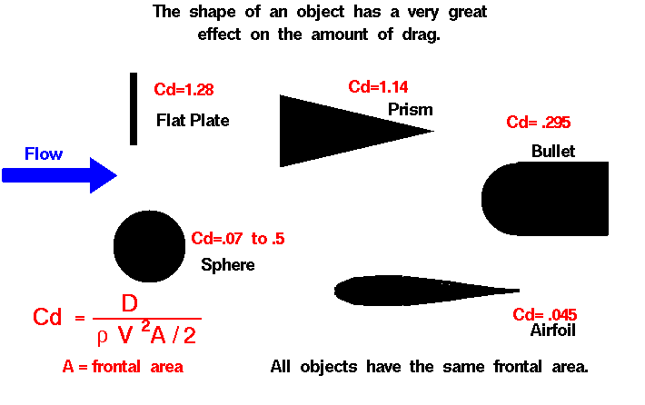
Design of Electric Vehicle
Distance s = E_{b}v/P_{D}
An electric vehicle has the following attributes: drag coefficient C_{d} = 0.25, vehicle cross section A = 2 m², and available propulsion energy of E_{b} = 20 kWh (1kWh = 3 6×10⁶ J).
Let the density of air ρair = 1.2 kg m−3.
Instantaneously at a vehicle speed of 120 km/h, calculate the aerodynamic drag force, power, and range, while driving in (a) calm conditions with no wind and (b) windy conditions with a 12 km/h headwind and (c) windy conditions with a 12 km/h tailwind.
‹#›

Slide 4
Design of Electric Vehicle
2. Rolling Resistance
The rolling resistance is the combination of all frictional load forces due to the deformation of the tire on the road surface and the friction within the drivetrain. The rolling resistance FR is described by the equation
F_{R} = m*g*μ
m = Mass of the vehicle in kg including Payload (Typical values: Vehicle weight = 150 kg ; Payload = 218 kg including 1 driver (75 kg), 2 passengers (68 kg) and luggage (7 kg))
g = Acceleration due to gravity = 9.81 m/s²
μ = Rolling resistance coefficient (Typical value: 0.013)
Note that the energy dissipated by the rolling resistance increases the tire temperature and pressure
Problem:
An electric vehicle has the following attributes: coefficient of rolling resistance μ = 0.0085 and vehicle mass of 2000 kg. Instantaneously at a vehicle speed of 10 km/h, calculate the rolling resistance and power. Let g = 9.81 m/s².

Slide 5
Design of Electric Vehicle
3. Gradient Resistance
The vehicle load power can increase or decrease depending on whether the car is ascending or descending an incline. The climbing resistance or downgrade force is given by
F_{G} = m*g*sinθ
θ = Angle of inclination
g = Acceleration due to gravity = 9.81 m/s²
The climbing force is positive, resulting in motoring operation. The downgrade force is negative and can result in energy regeneration to the battery, a mode commonly used in electrically propelled vehicles rather than friction braking to slow the vehicle.
Problem:
A 20 kW rated Vehicle is traveling down a 6 in both positive and negative slope at 120 km/h and 40 km/h respectively. Assuming calm conditions, how much regenerative power is available to brake the vehicle while maintaining a constant speed? And also, calculate the power required to drive in positive slope.

Slide 6
Design of Electric Vehicle
4. Acceleration
Nominal vehicle power requirements are typically based on vehicle acceleration requirements, usually specified as the time to accelerate from 0 to 100 km/h (62 mph) or from 0 to 60 mph. Under these conditions, the maximum available torque and power of the propulsion system are likely to be required.
As per Newton’s second law of motion for a linear system, the force required to accelerate or brake a vehicle Fa is given by
F_{A} = m*a = m dv/dt
s = Acceleration distance
a = Acceleration = Distance travelled / time
m = Mass of the vehicle in kg including Payload (Typical values: Vehicle weight = 150 kg ; Payload = 218 kg including 1 driver (75 kg), 2 passengers (68 kg) and luggage (7 kg))
Problem:
A Vehicle is having a weight of 1200 kg and the vehicle reaches to 0.1 km with in 5 seconds. Assuming calm conditions, how much the acceleration force is required and power consumption from the source during acceleration.

Slide 7
Design of Electric Vehicle
Summary of EV Design:
The force propelling the vehicle forward, the tractive effort, has to accomplish the following:
overcome the rolling resistance;
overcome the aerodynamic drag;
provide the force needed to overcome the component of the vehicle’s weight acting
down the slope;
accelerate the vehicle, if the velocity is not constant.
Total tractive effort
The total tractive effort is the sum of all these forces:
F_{tr} = F_{D}+F_{R}+F_{G}+F_{A}
where:
• FR is the rolling resistance force;
• FD is the aerodynamic drag;
• FG is the hill climbing force;
• FA is the force required to give acceleration.
We should note that FA will be negative if the vehicle is slowing down, and that FG will be negative if it is going downhill.
‹#›

Slide 8
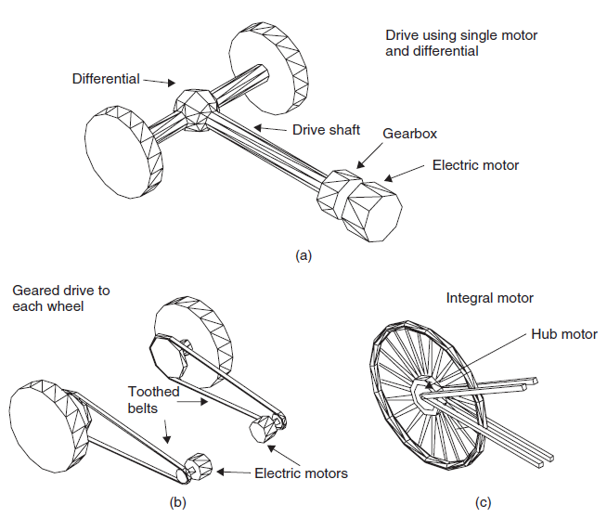
Design of Electric Vehicle
Transmission Efficiency
The transmission of electric vehicles is inherently simpler than that of IC engine vehicles.
To start with, no clutch is needed as the motor can provide torque from zero speed upwards.
Similarly, a conventional gearbox is not needed, as a single-ratio gear is normally all that is needed.
Three different arrangements for electric vehicle transmission: (a) drive using single motor and differential; (b) geared drive to each wheel; and (c) integral motor
‹#›

Slide 9
Design of Electric Vehicle
Differential Drive:
The most conventional arrangement is to drive a pair of wheels through a differential. This has many advantages, Reliable, quantity-produced piece of engineering. The disadvantage is that some power is lost through the differential, and differentials are relatively heavy. It can also take up space in areas where the space can be usefully utilized.
Geared drive with toothed belt:
The differential can be eliminated by connecting a motor to each wheel via a single ratio gearbox or even a toothed belt drive. The torque from each wheel can be set by the electronic controller. This system has the advantage of clearing space within the vehicle, and the disadvantage of needing a more complicated electronic controller. Also, in terms of cost per kilowatt, two small motors are considerably more expensive than one larger one.
Integral Motor Drive:
The third method is to connect the motor directly to the wheels via a shaft, or actually to design the motor as part of the hub assembly.
This system has huge potential advantages, including a 100% transmission efficiency. The trouble with this system is that most electric motors typically run at two to four times faster than the vehicle’s wheels, and designing a motor to work slowly results in a large heavy motor. However, this arrangement has and can be used. It is particularly popular in electric motors scooters and bicycles.
‹#›

Slide 10
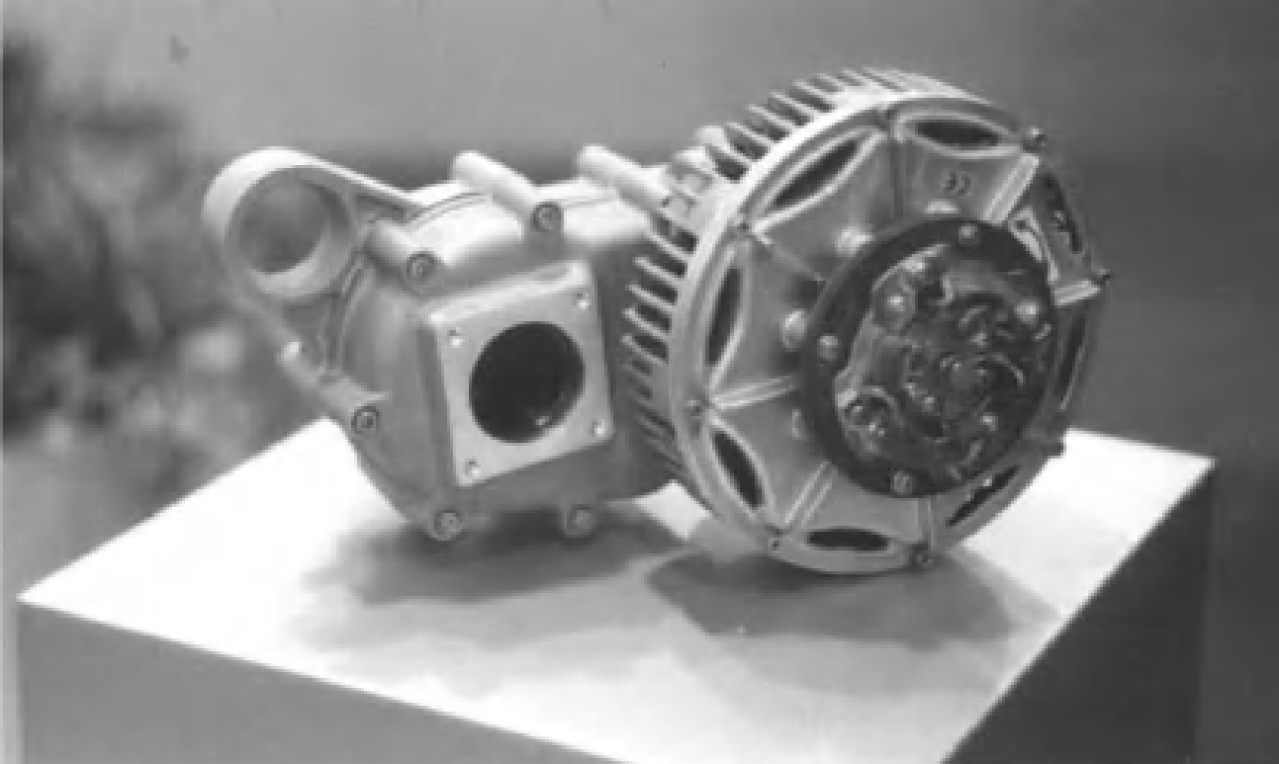
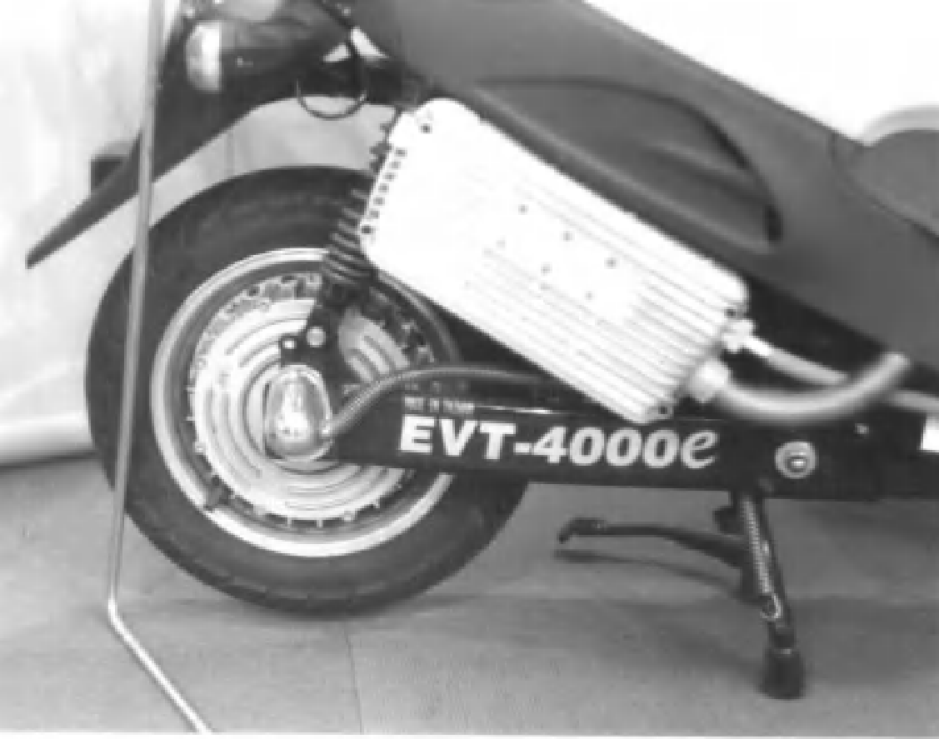
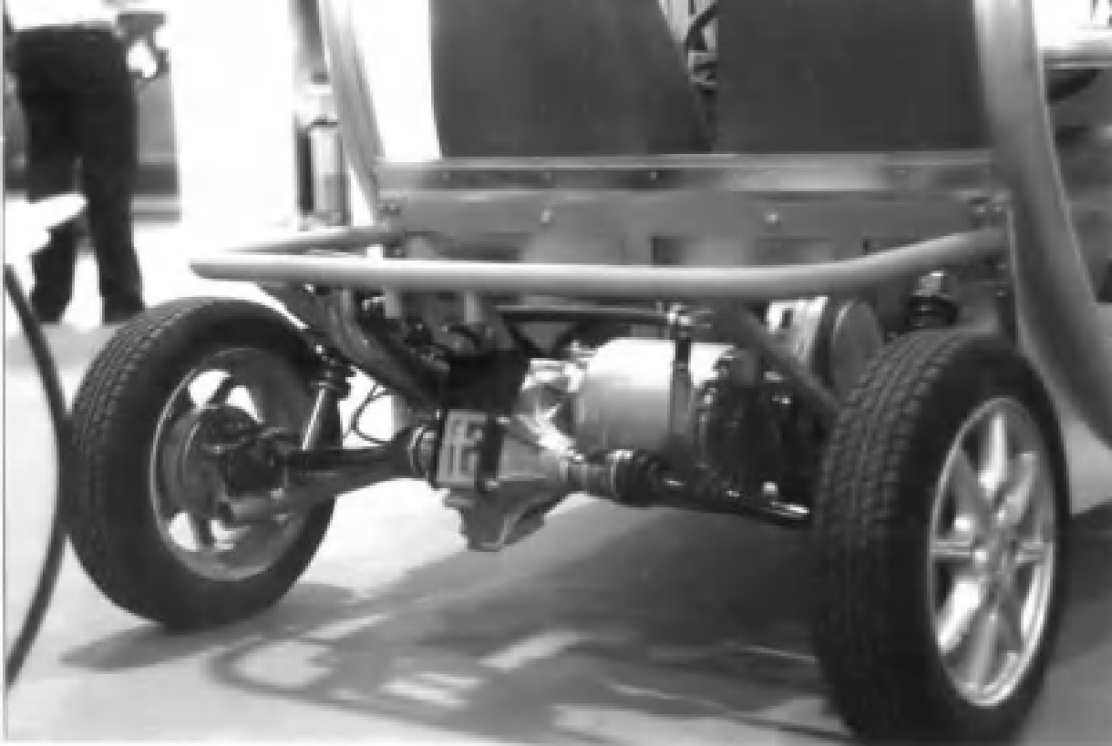
Design of Electric Vehicle
Integral Motor Drive:
‹#›

Slide 11
Design of Electric Vehicle
Exercise Problems:
1. An Electric vehicle has to be designed with 1200 kg of net weight for the following assumptions, Drag coefficient C_{d} = 0.44, rolling resistance is 1.3 % of frictional load force, Frontier area = 2 m², battery is rated with 50 units of energy, Density of air ρ = 1.2 kg m⁻³. The driving profile details are, A vehicle has reached 0.2 km with in 15 seconds and average speed is 50 km/h. Neglect the transient responses. Estimate the following,
The aerodynamic drag force, Rolling resistance force, Gradient force and Acceleration force.
2. And also, calculate the maximum assured mileage of EV for 15 km/h head and tail wind velocity.
3. What is the H.P rating of the motor with power train efficiency of 88 %?
4. How much greater is the power requirement for climbing in 10 degree slope compared to a flat road?
2. An electric drive features a 24 kWh battery pack and has a range of 170 km at a constant speed of 88 km/h. What is the new range when traveling at 88 km/h if the heating, ventilation, and air conditioning draw a constant power of 6 kW?
3. On a 20°C sunny day with no wind speed, and an air density of 1.2 kg/m³, a 1450 kg vehicle travels in roadway with a 6°grade at 100 km/h and a rolling resistance coefficient of 0.013. The vehicle center of gravity is located 0.6 m from the ground in the center of the 2.5 m wheelbase with 0.66 m wheels and has a frontal area of 2.05 m² and a drag coefficient of 0.32. Calculate the aerodynamic, grading, and rolling resistance forces.

Slide 12
Design of Electric Vehicle
4. An electric vehicle has the following attributes: mass m = 500 kg, wheel radius r = 0.3 m, gear ratio from rotor to drive axle n_{g} = 10, and a nominal gear efficiency ηg = 95%. The vehicle is required to accelerate linearly from 0 to 36 km/h in 5 s on a flat road surface under calm wind conditions. Neglecting load forces, calculate the electromagnetic torque from the electric motor to achieve this acceleration torque.
5. The vehicle of Problem 4 is required to decelerate linearly from 36 to 0 km/h in 5 s on a flat road surface under calm wind conditions. Neglecting load forces, instantaneously at 18 km/h calculate the regenerative torque to the electric motor to achieve this braking.
6. After some engine and transmission performance upgrades, the same vehicle is taken to a test track to find out the new vehicle top speed. The upgrades have increased engine torque to 450 Nm and engine horsepower to 300 kW and an overall powertrain efficiency of 88%. After the upgrades, the minimum gear ratio of the transmission is 0.9, and the differential gear ratio is 3.21. Calculate the maximum speed of the vehicle.
‹#›

Slide 13
Design of Electric Vehicle
7. An electric car is climbing at 80 km/h up a 5° incline against a 10 km/h headwind. The vehicle has the following attributes: mass m = 1400 kg, drag coefficient C_{d} = 0.19, vehicle cross section A = 2.4 m², coefficient of rolling resistance C_{R} = 0.0044, wheel radius r = 0.3 m, gear ratio from rotor to drive axle n_{g} = 11, and a nominal gear efficiency ηg = 95%. Assume a density of air ρ_{air} = 1.2 kg m-3.
i) Calculate the rotor output torque and speed.
ii) How much greater is the power requirement for climbing the 5° slope compared to a flat road?
‹#›

Slide 14
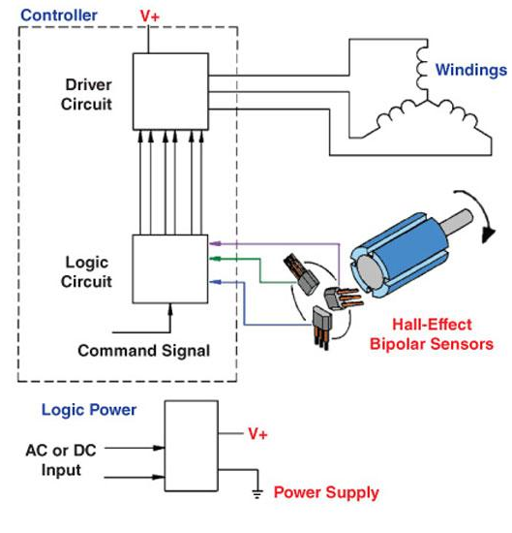
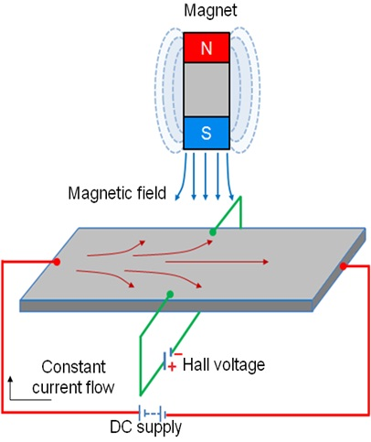
Essential Elements:
Brushless DC motor in EV Drives
Notes:
‹#›

Slide 15
Brushless DC motor in EV Drives
Mechanical Commutator Vs Electronic Commutator:
Mechanical Commutator | Electronic Commutator
It is made up of commutator segments and mica insulation. Brushes are made up of carbon or graphite. | Power Electronic switching devices are used in the commutator.
Commutator arrangement is located in the rotor. | Commutator arrangement is located in the stator.
Shaft position sensing is inherent in the arrangement. | It requires a separate rotor position sensor.
Number of commutator segments are very high. | Number of switching devices is limited to 6.
Sliding contact between commutator and brushes. | No sliding contacts.
Sparking takes place. | There is no sparking.
It requires a regular maintenance. | It requires less maintenance.
Difficult to control the voltage available across tapping's. | Voltage available across armature tappings can be controlled by PWM techniques.
Highly reliable. | Reliability can be improved by specially designed devices and protecting circuits.

Slide 16
Brushless DC motor in EV Drives
BLDC Motor operation is based on the attraction or repulsion between magnetic poles.
Using the three-phase motor as shown in figure below, the process starts when current flows through one of the three stator windings and generates a magnetic pole that attracts the closest permanent magnet of opposite pole.
The rotor will move if the current shifts to an adjacent winding. Sequentially charging each winding will cause the rotor to follow in a rotating field.
The torque in this example depends on the current amplitude and the number of turns on the stator windings, the strength and the size of the permanent magnets, the air gap between the rotor and the windings, and the length of the rotating arm.
Compared with a brushed DC motor or an induction motor, the BLDC motor has many advantages:
Higher efficiency and reliability
Lower acoustic noise
Smaller and lighter
Greater dynamic response
Better speed versus torque characteristics
Higher speed range
Longer life

Slide 17
Brushless DC motor in EV Drives
Sequence | Hall Sensor Input |  |  | Active PWM |  | Phase Current
1
2
3
4
5
6
CW
Sequence | Hall Sensor Input |  |  | Active PWM |  | Phase Current
1
2
3
4
5
6
CCW
Notes:
‹#›

Slide 18
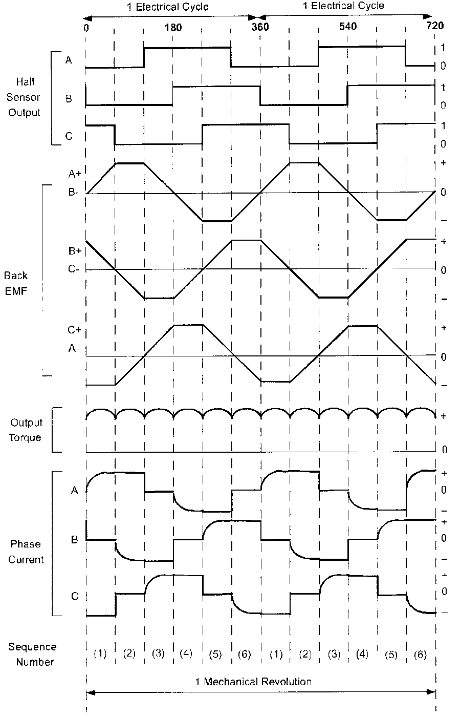
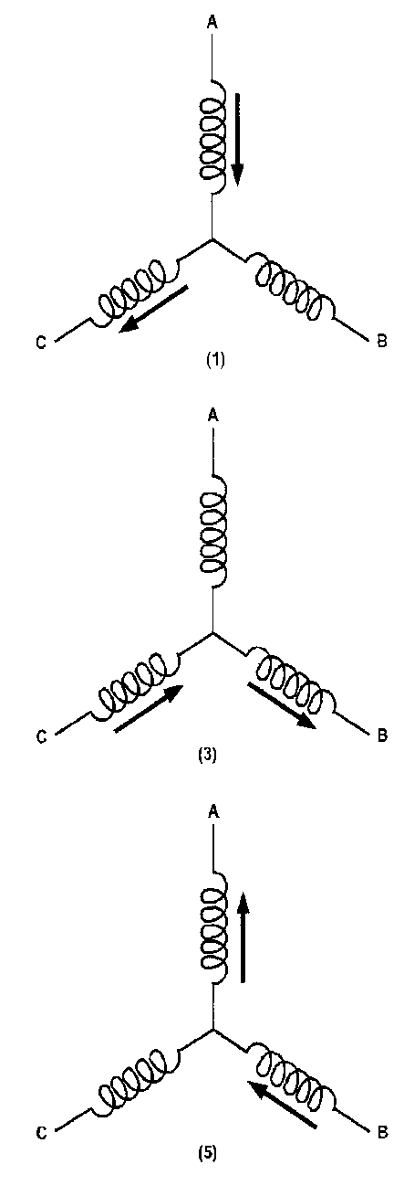
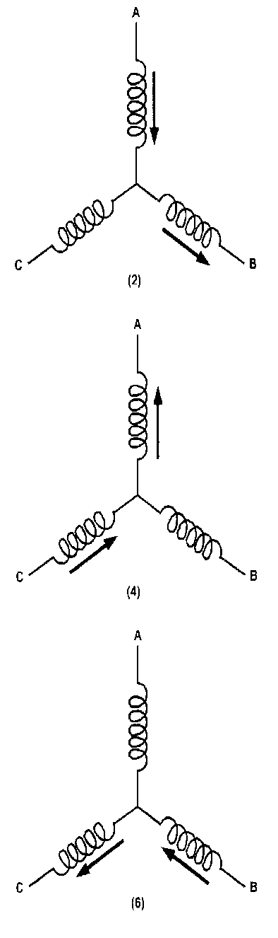
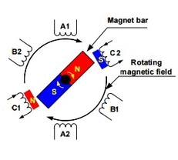
Brushless DC motor in EV Drives
Notes:
‹#›

Slide 19
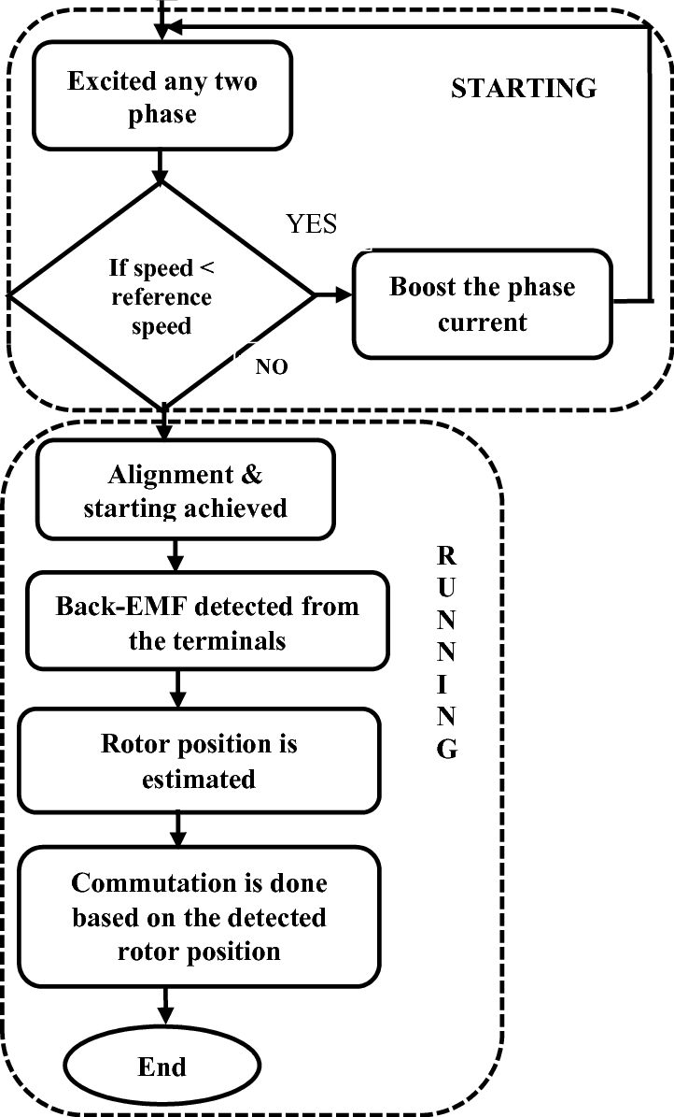
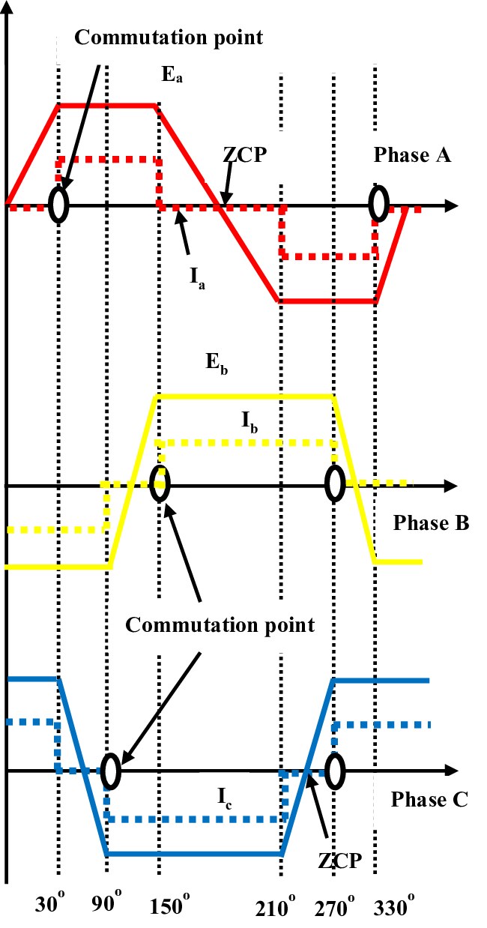
Brushless DC motor in EV Drives
Phase Back EMF of BLDC Motor
Flowchart of the Back-EMF Zero Crossing Speed Sensing

Slide 20
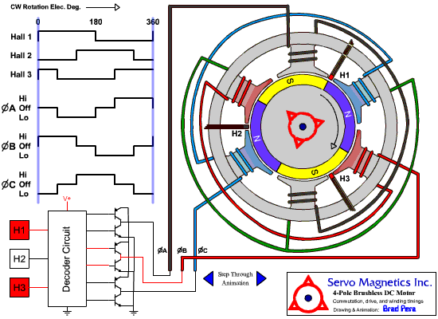
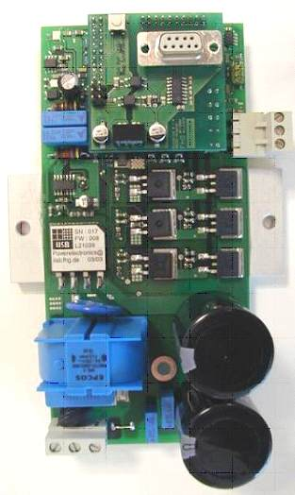
Brushless DC motor in EV Drives
4 – Pole BLDC Motor with position detector
(Hall Sensor)
Notes:
‹#›

Slide 21
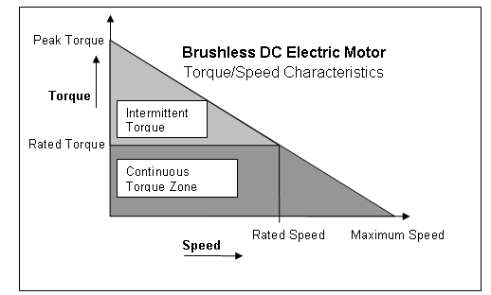
Brushless DC motor in EV Drives
Speed-torque Characteristics
The speed is essentially controlled by the voltage, and may be varied by varying the supply voltage. The motor then draws just enough current to drive the torque at this speed. As the load torque is increased, the speed drops, and the drop is directly proportional to the phase resistance and the torque. The voltage is usually controlled by chopping or PWM.
This gives rise to a family of torque/speed characteristics in the boundaries of continuous and intermittent operation. The continuous limit is usually determined by heat transfer and temperature rise.
The intermittent limit may be determined by the maximum ratings of semiconductor devices in the controller, or by temperature rise. In practice the torque/speed characteristic deviates from the ideal form because of the effects of inductance and other parasitic influences.

Slide 22
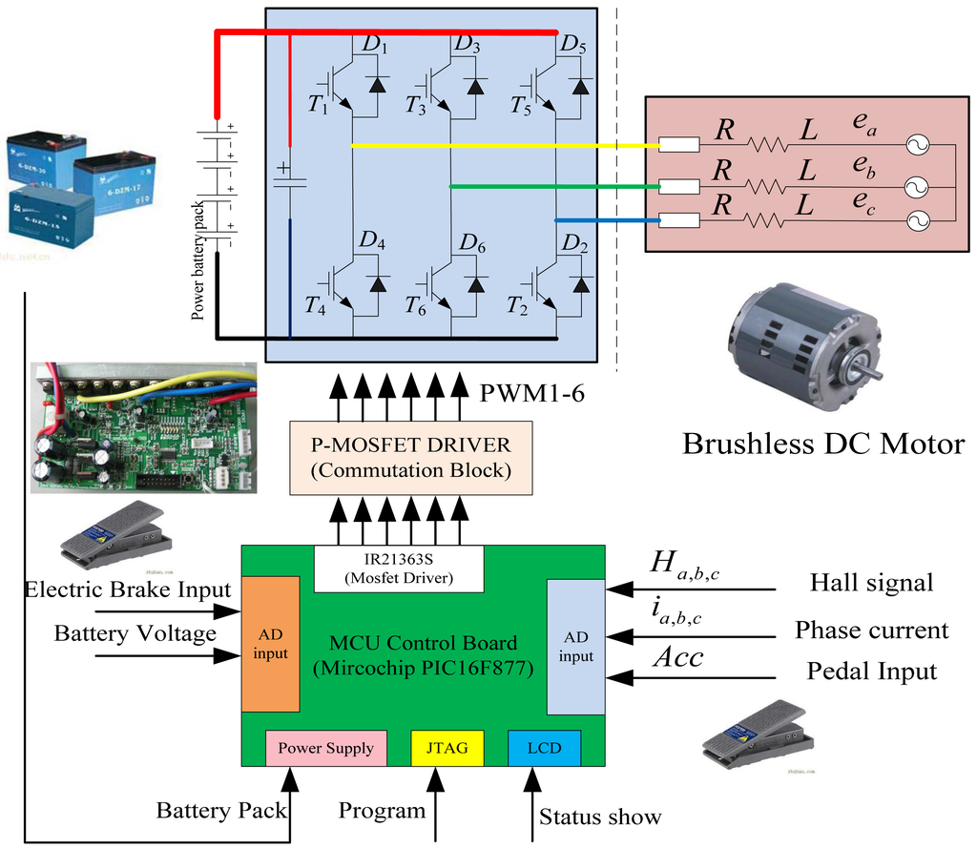
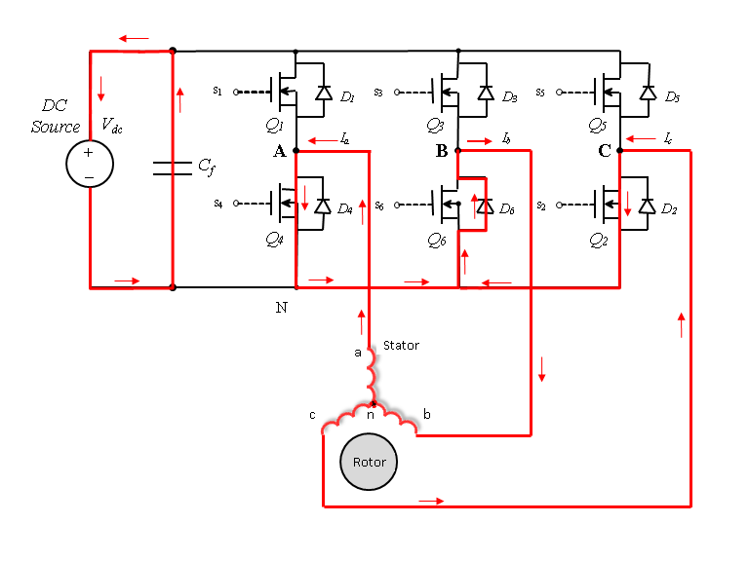
Brushless DC motor in EV Drives
Regenerative braking
Regeneration Mode Table???

Slide 23
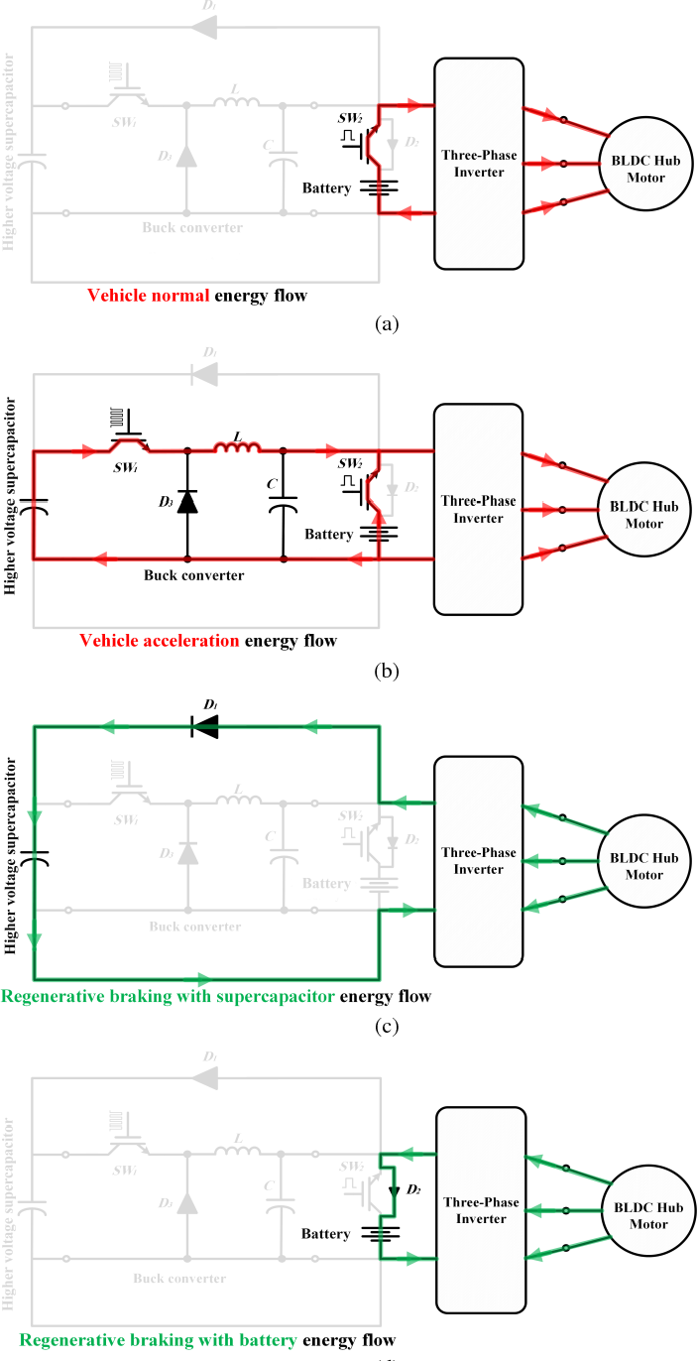
Brushless DC motor in EV Drives
Regenerative braking

Slide 24
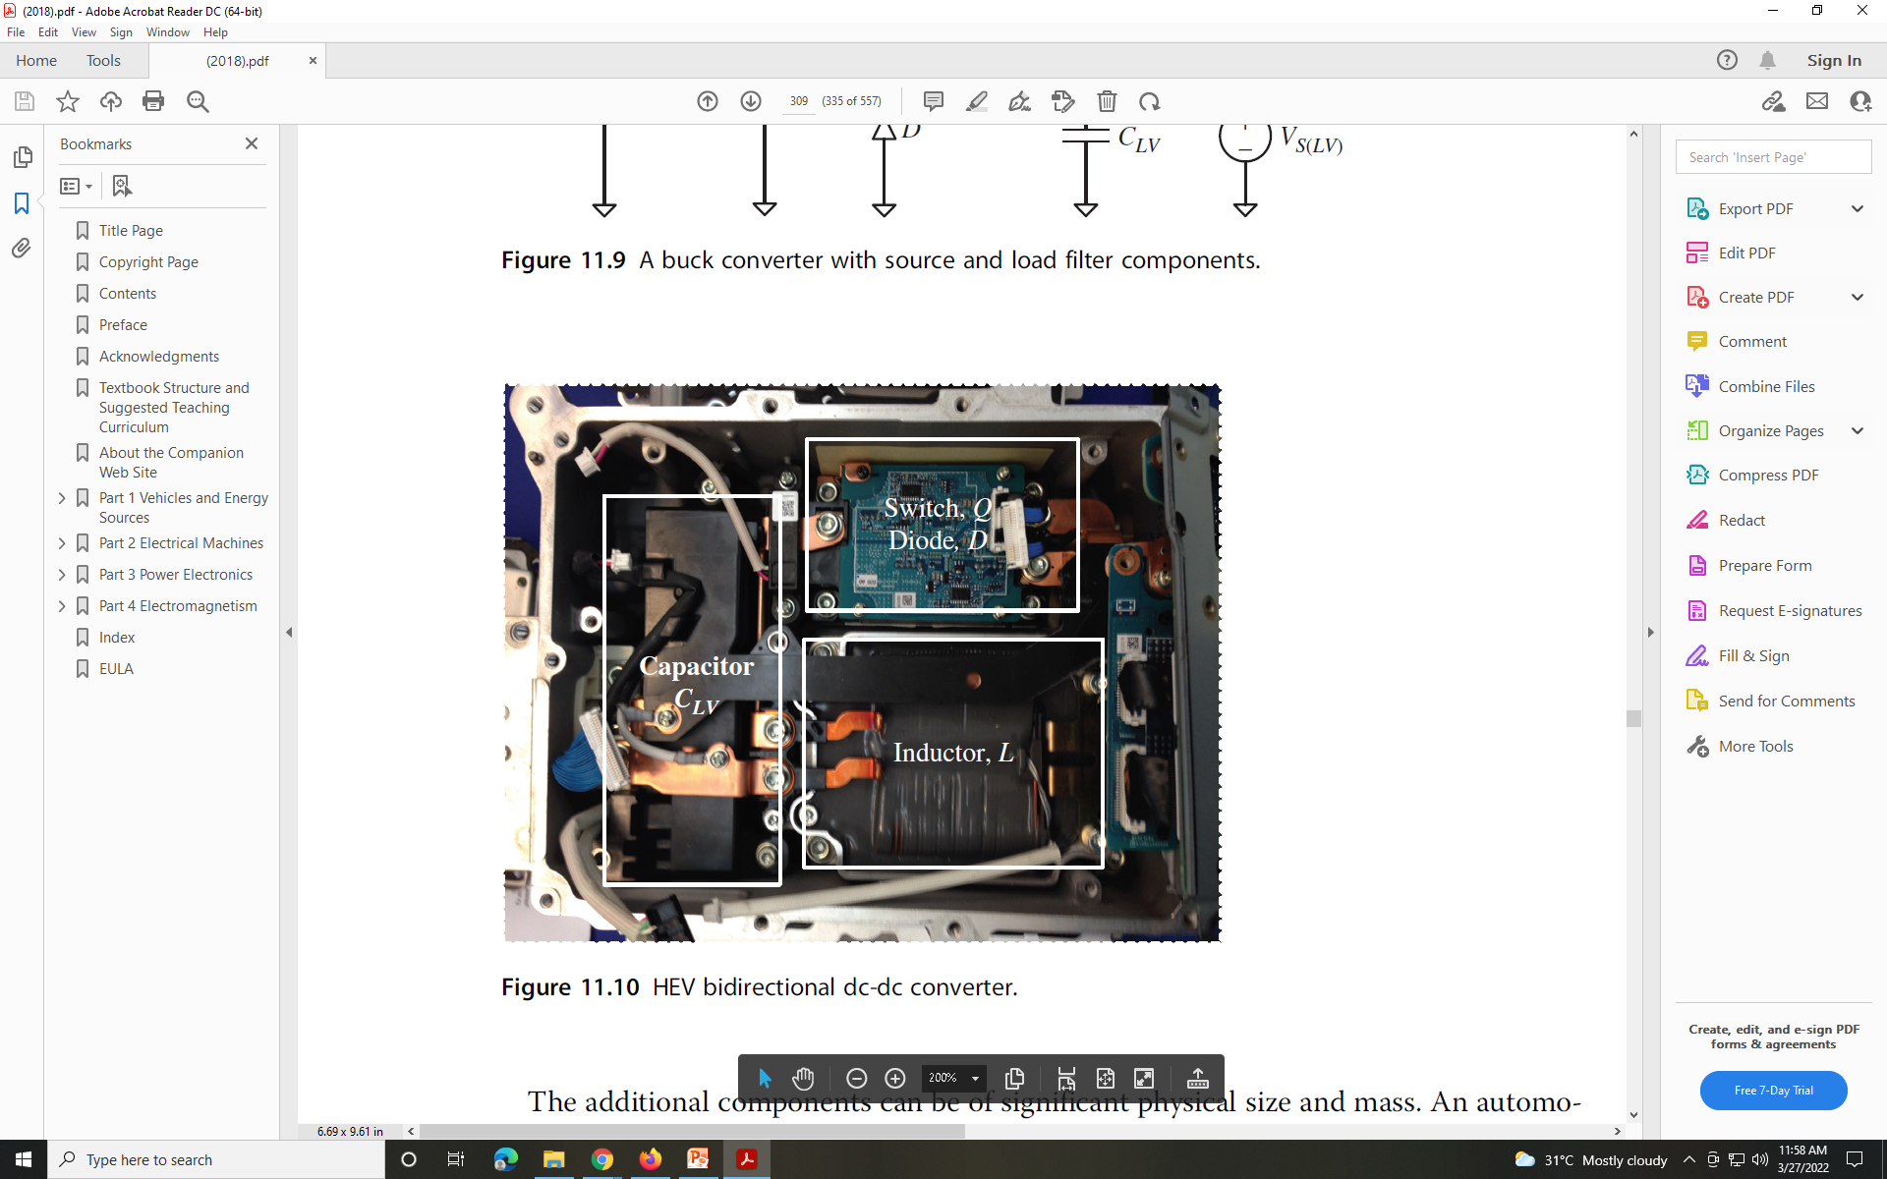
Brushless DC motor in EV Drives
HEV bidirectional dc-dc converter

Slide 25
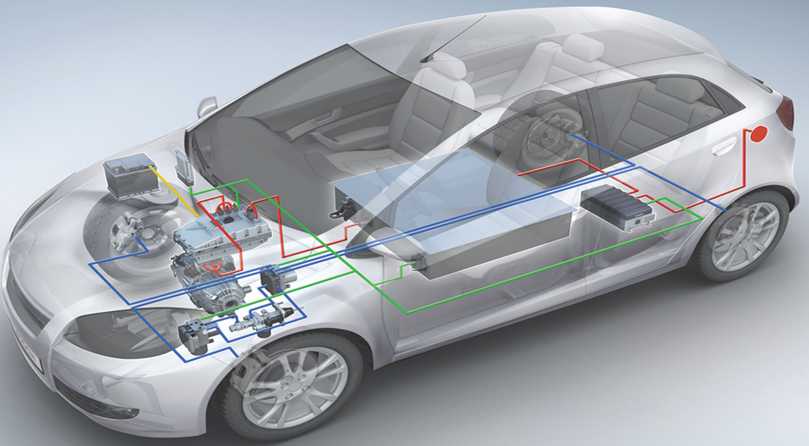
PM Synchronous Motors in EV Drives
Construction
Stator identical to that of a three-phase induction motor – now called the “armature”
Energize from a three-phase supply and develop the rotating magnetic field
Rotor has a DC voltage applied (excitation)
Rotor could be a permanent-magnet type
Operation
Magnetic field of the rotor “locks” with the rotating magnetic field – rotor turns at synchronous speed

Slide 26
PM Synchronous Motors in EV Drives
Limitations in PMSM for EV Drives
In PMSM Drives , the stator supply frequency is controlled from outside by using a separate oscillator.
The frequency is changed from one value to the other gradually so that the difference between synchronous speed and rotor speed is small during any speed change.
This gradual change in frequency helps the rotor to follow the stator speed properly at all operating points.
When the desired speed is reached, the rotor gets locked with the stator flux speed (rotor pulls into step) after hunting oscillations.
The frequency command f* is applied to the VSI through a delay circuit. This delay circuit ensures that the rotor follows the stator speed.

Slide 27
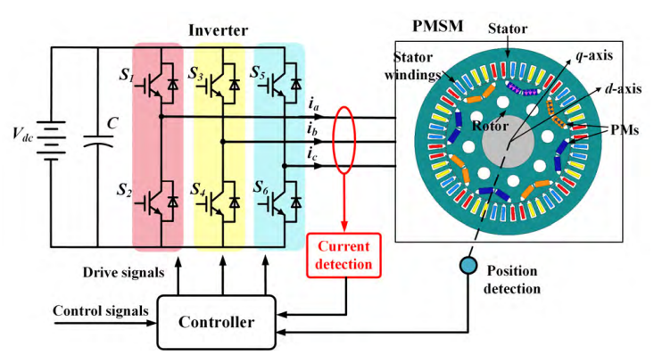
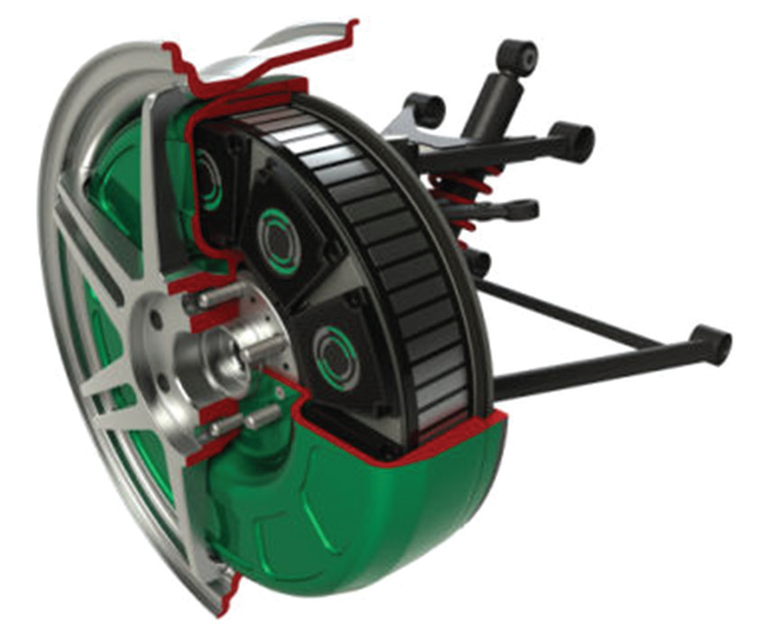
PM Synchronous Motors in EV Drives
In-wheel motor
With position based control, the stator supply frequency is changed proportional to the rotor speed.
Hence the stator rmf rotates at the same speed as the rotor speed.
It means that the instants at which the switching devices operate to turn the stator windings ON and OFF is determined by the rotor position sensors.
With the increase in the speed of EV, if the rotor slows down, then the stator supply frequency automatically changes so that the rotor remains synchronized with the rotating field.
This ensures that the rotor moves in synchronism with stator at all operating points of EV.
Consequently this controlled mechanism will never come out of synchronism or step.
It does not suffer from hunting oscillations.

Slide 28
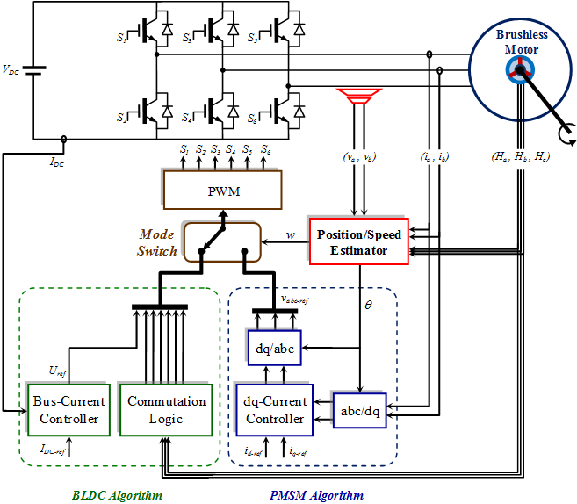
Hybrid Drives (PMSM and BLDC) for EV
Notes:
‹#›

Slide 29

Comparison of BLDC Motor with DC Motor and IM

Slide 30
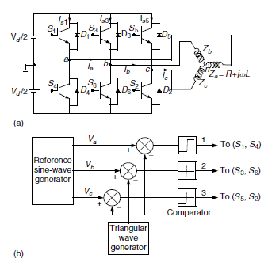
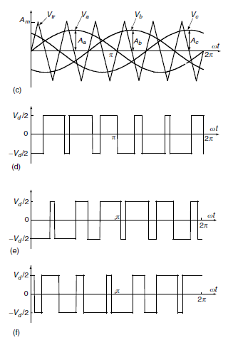
Induction Motor in EV Drives (VV-VF)
V = m ⋅ ^{Vd} = 0.354mV
An,1 d
2 2
where m is the depth of modulation

Slide 31
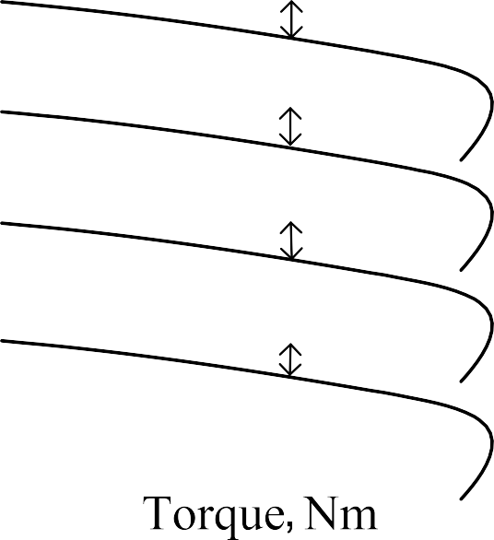


Induction Motor in EV Drives (VV-VF)
^{Kϕˆ} gap
V₁
Benefits: .
Simple installation and maintenance.
Low motor starting current.
Energy savings.
Reduced mechanical and thermal stress on motors and belts during start.
High power factor
Rated
f_{o}
f₁
Slip freq, sf₁
Slip freq, sf₁
n_{o}
n₁
n_{o}
_{I}'
2
^{T}dev
f_{o}
f
o
n
f
1
f₁
n
1
n₂
n₃
2
f₂
f₂
f₃
n₃
sf₁
f₄
I’₂

Slide 32
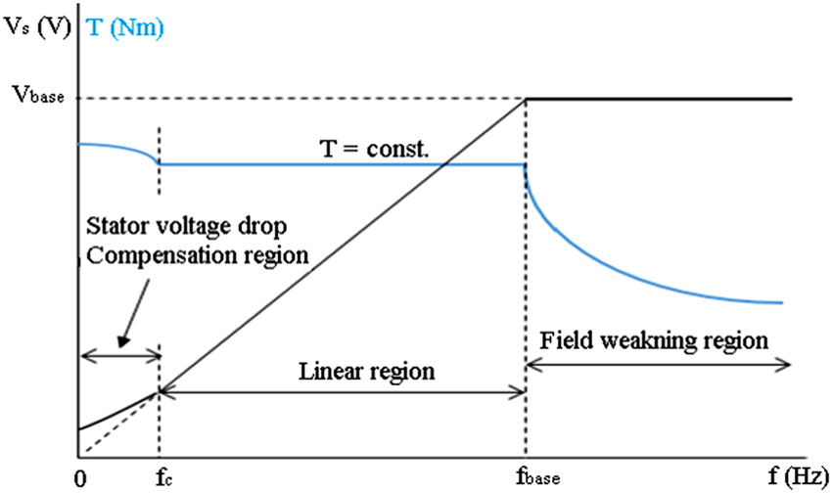
Induction Motor in EV Drives (VV-VF)
Constant max torque and power characteristics
Rated V₁ & f_{o}
Speed, Rad/sec
V₁
Reference
Speed reference
1
1+ T_{f} s
T_{dev} Nm
^{T}max
f₁
Reference
T- ω characteristics under VVVF drive with f₁ below and above f_{o}
Simple V/f controller

Slide 33
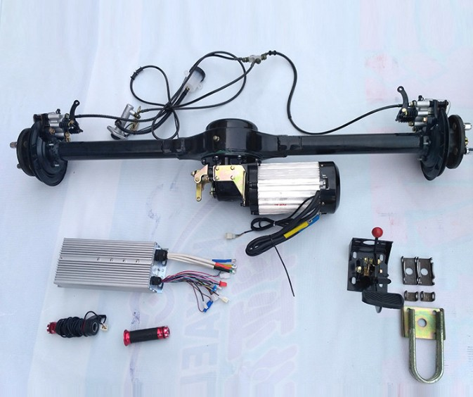
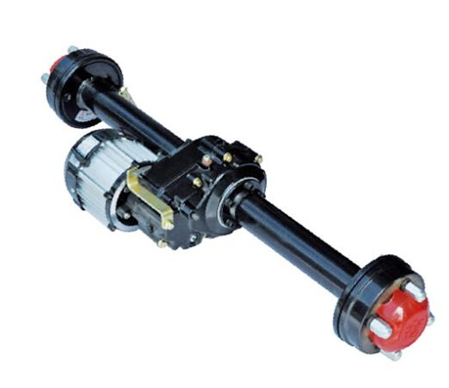
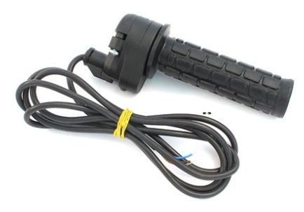
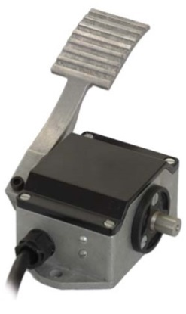
Induction Motor in EV Drives (VV-VF)
Rear Axle System
0-5k Ohm Hand throttle
0-5k Ohm
foot pedal throttle

Slide 34
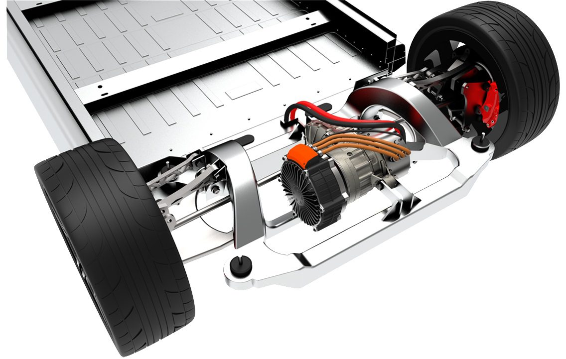
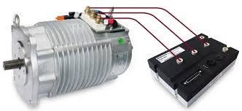
Induction Motor in EV Drives (VV-VF)

Slide 35
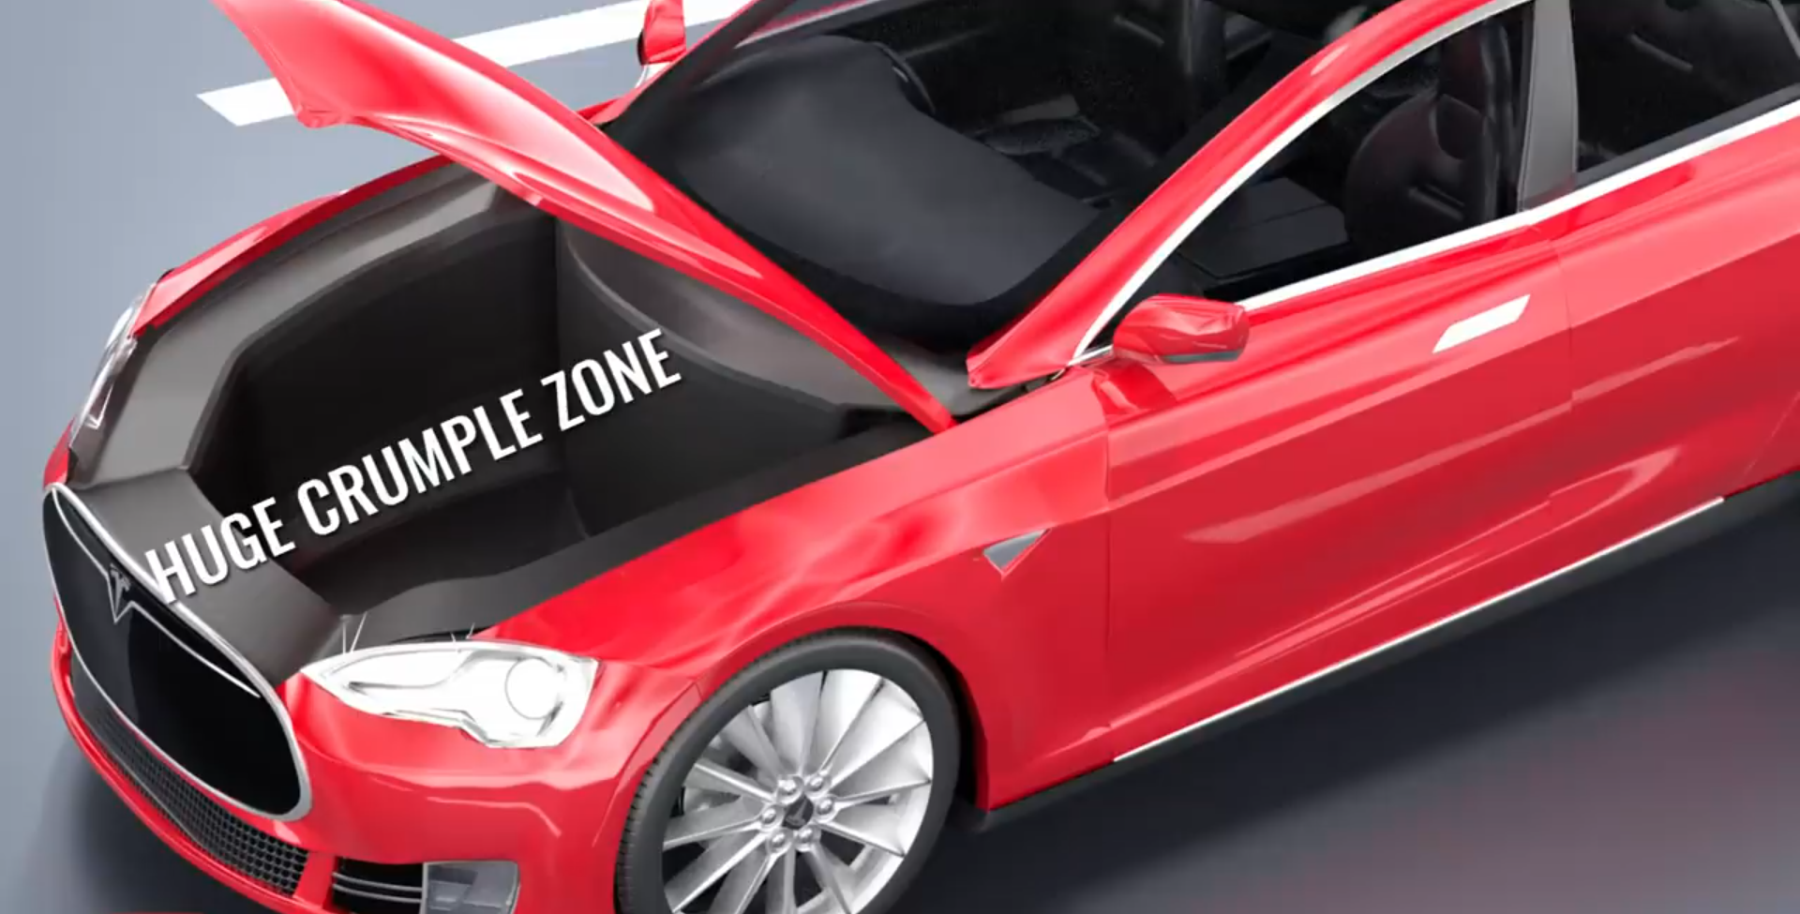
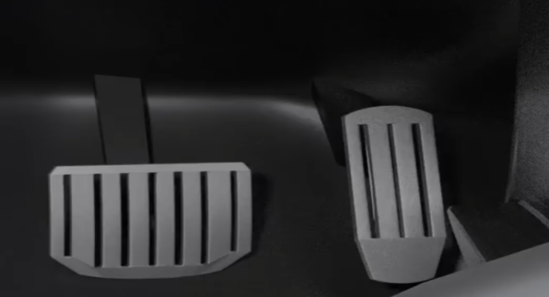
Induction Motor in EV Drives (VV-VF)

Slide 36
Top Manufacturers List in EV
Top Manufacturers in EV field:
Tesla Model 3
BMW i3
Chevy Bolt
Chevy Spark
Nissan LEAF
Ford Focus Electric
Hyundai Ioniq
Karma Revera
Kia Soul
Mitsubishi i-MiEV
Tesla Model S
Tesla X
Toyota Rav4
Volkswagen e-Golf
Top Manufacturers in PHEV field:
Chevy Volt
Chrysler Pacifica
Ford C-Max Energi
Ford Fusion Energi
Mercedes C350e
Mercedes S550e
Mercedes GLE550e
Mini Cooper SE Countryman
Audi A3 E-Tron
BMW 330e
BMW i8
BMW X5 xdrive40e
Fiat 500e
Hyundai Sonata
Kia Optima
Porsche Cayenne S E-Hybrid
Porsche Panamera S E-hybrid
Toyota Prius
Volvo XC90 T8

